Slide 1
Bureau of Land Management
2023

Slide 2
BLM
All resources assigned to an incident will follow incident agency requirements when staying at incident base or other location. Individuals are not automatically entitled to claim lodging or M&IE. An individual assigned to an incident where sleeping arrangements and meals are provided must have written authorization with justification from the Agency Administrator to obtain lodging and claim meals. (If not on RO)
Charge card adjustments for all incident charges will be made by the home organization (state, district, or field office). In order to pull the information needed from FBMS, the following format is required in the description field when reallocating charge card transactions: description of the item and the request number as indicated on the resource order in block 12 (i.e., a supply order would read S140 Office Supplies or, for overhead, O235 Lodging).

Slide 3
BLM, AFS Incident Business Organization
Kent Slaughter AFS Manager
Susan Vincent State Incident Business Specialist
Branden Petersen Tanana Zone FMO
Krissy Kappus
Zones Fire Business Supervisor
Paula McQuestion
Zone Admin
Danielle Lacroix Zone Admin
Nichole Nickols Zone Admin
VACANT Zone Admin

Slide 4
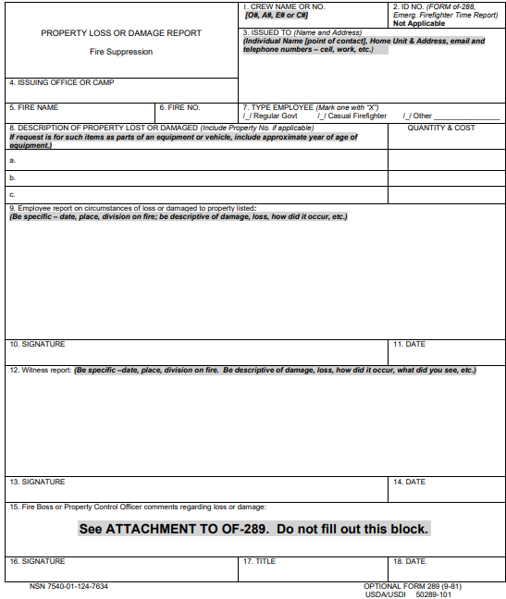
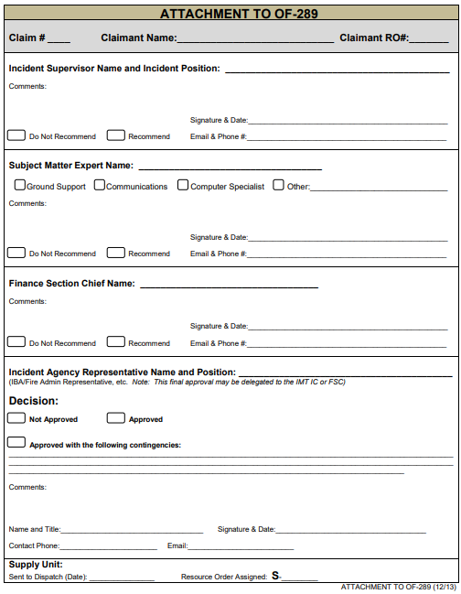
BLM, Alaska Fire Service (AFS)
BLM AFS requires the 2-page OF289, Government Property Loss & Damage Report

Slide 5
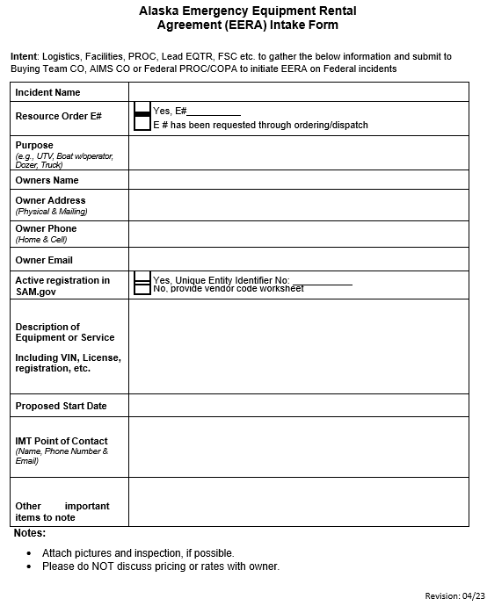
BLM, Alaska Fire Service (AFS)
Similar to the Land Use Agreement intake form, BLM AFS requires an EERA intake form to be completed and submitted when requesting an EERA through the dispatch ordering process.

Slide 6
BLM, Alaska Fire Service (AFS)
All documentation will follow the NWCG Standards for Electronic Documentation in the most current, updated format.
Electronic documentation will be in accordance with IBC Standards for Electronic Records Management for Incidents: https://www.nwcg.gov/committees/incident-business-committee/correspondence

Slide 7
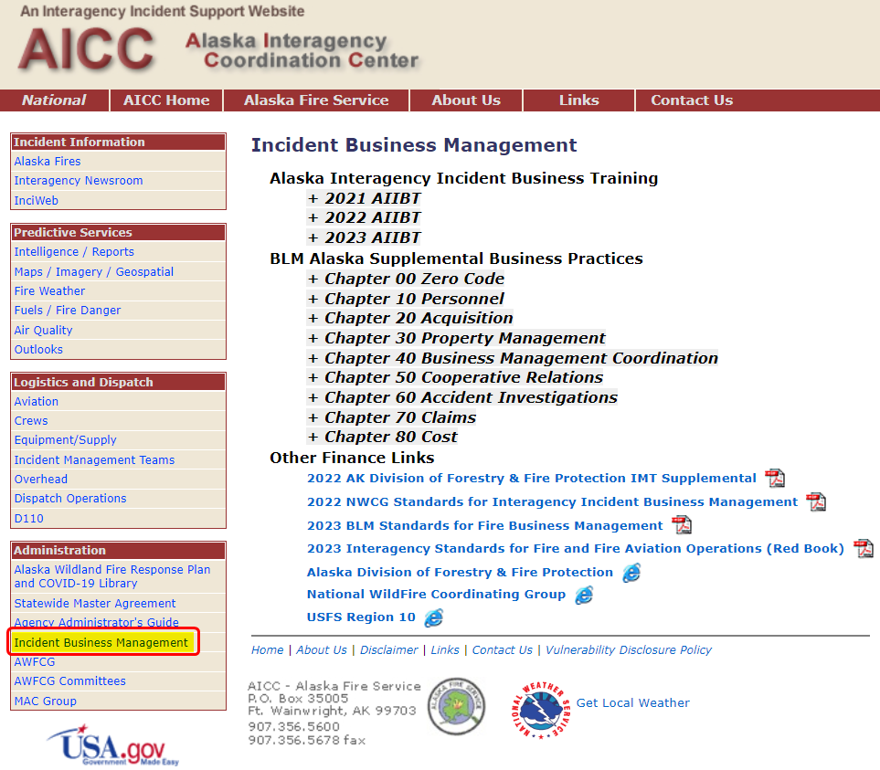
BLM, Alaska Fire Service (AFS)
All references are available on the AICC Website

